Slide 1

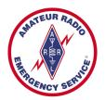
Training Volunteers
The ARRL
Introduction to Emergency Communication Course
EC-001 (2011)
Session One
Notes:
Make sure you have modified the Name and Date.
Display this screen as students are arriving for class.

Slide 2
Reminder
Complete two DHS/FEMA Courses
IS-100.b Introduction to ICS
IS-700 National Incident Management System
Http://training.fema.gov/IS/NIMS.asp
Notes:
ARRL conditions!
The two ICS courses must be complete before taking the final exam.

Slide 3
Session One Topic
Session 1 – Topics 1, 2, 3, 4, 5a, 5b
Session 2 – Topics 6, 7a, 7b, 7c, 7d, 8, 9, 10
Session 3 – Topics 11, 12, 13, 14, 15
Session 4 – Topics 16, 17, 18, 19, 20
Session 5 – Topics 21, 22, 23, 24, 25, 26, 27
Session 6 – Topics 28, 29, Summary, Final Exam
Notes:
The course requires a total of 18 hours.
If a student misses one class they can take a practice quiz for each lesson missed.
A student missing two sessions will be asked to take the course again.
A student missing the last session must wait for the next class and attend the final session for taking the exam again.
An exception would be two Field Examiners agreeing to give the exam at a mutually scheduled time.

Slide 4
Topic 5a - Served Agency Communication Systems

Slide 5
State and Local Government Radio Systems
Police, Fire, Sheriff, DPS
SOP
ITU – APCO Phonetics
10 Codes vs. Plain Language
No Causal Conversations
155.475 MHz - National Police Frequency
Notes:
In an emergency situation, these shared channel systems can quickly become overloaded. A common practice is to end all non-essential communications or perhaps move them to an Amateur system instead.

Slide 6
State and Local Government Radio Systems (cont)
Large city and state police; and fire radio systems
More than one channel, assigned to different purposes
FCC allocates specific radio frequencies to different types of agencies, and some for multi-agency use
A frequency designated for use by police agencies may only be used for police business

Slide 7
Emergency Medical Radio Systems (EMRS)
FCC assigned dedicated standardized frequencies
Older MedStar
10 VHF simplex
Ambulance - Hospital
Newer EMRS
10 UHF duplex
Med 1 to Med 10
7 VHF simplex

Slide 8
American Red Cross
Nationally licensed frequency 47.42MHz
Primarily for disaster or emergency operations
Some chapters also use 47.50MHz
Chapters may rent space on commercial systems or license their own VHF or UHF systems for day-to-day operations

Slide 9
Types of Served-Agency Radio Systems
Dispatch vs. Operational Channels
Community Repeater Systems
Trunked Repeater Systems
Shared Simplex Systems
Notes:
In an emergency situation, these shared channel systems can quickly become overloaded. A common practice is to end all non-essential communications or perhaps move them to an Amateur system instead.

Slide 10
Community Repeater Systems
“Community" or "shared" repeater uses a different CTCSS tone for each user group
Each department uses a different CTCSS tone
When using any shared frequency -- repeater or simplex -- it is important to press the "monitor" button for a moment before transmitting.
Disables the CTCSS decoder, temporarily allowing you to hear any transmissions being made on the frequency
Notes:
In an emergency situation, these shared channel systems can quickly become overloaded. A common practice is to end all non-essential communications or perhaps move them to an Amateur system instead.

Slide 11
Continuous Tone Controlled Squelch System
Motorola
Invented Continuous Tone Coded Squelch System or CTCSS
Patented it as "PL" short for "Private line".
Way to get more than one Land Mobile customer on the same frequency at almost the same time
Other manufacturers, finding that the system was absolutely necessary to stay competitive came up with
"Channel Guard" (CG)
"Quiet Channel"
"Call Guard"
And many other names for the same thing to avoid lawsuits for marketing a patented system

Slide 12
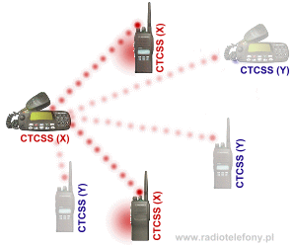
CTCSS

Slide 13
Trunked Systems
Allow several "low volume" users to share a single radio system
Several co-located repeaters tied together, using computer control to automatically switch a call to an available repeater
Once a radio in a group is switched to a new frequency, all the others in the group automatically follow
Channel switching and assignment data is transmitted on a dedicated channel
Amateur Radio does not currently use this type of system

Slide 14
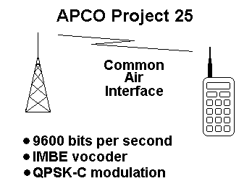

APCO Project 25 Radio Systems
P25 radios are extremely flexible
Operate in both analog and digital voice modes, and as part of trunked and conventional radio systems
Digital modes offer excellent audio quality, and optional encrypted modes offer message and data security
Advantage – different manufacturers
Not as effective in rural or mountainous areas
Reception of digital signals

Slide 15



Telephone Systems
Business telephone systems
Answering incoming calls
Placing outside calls
Placing and answering intercom calls
Making "speed dial" calls
Overhead paging
Placing calls on hold, and then retrieving them.
Transferring calls to another extension.
Transferring calls to voice mail, if available
Retrieving calls from a voice mail box
Good idea to keep user's manual close at hand

Slide 16


Satellite Telephones
Becoming more common among served agencies as the cost of ownership and airtime decreases
Require line-of-sight to the satellite
Typically expensive

Slide 17
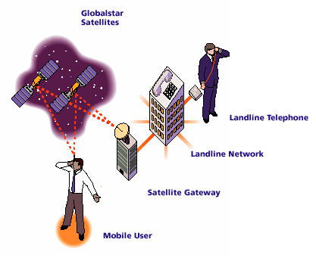
Satellite Telephones

Slide 18
Satellite Data Systems
Satellite systems in use by public service agencies vary greatly
Two-way data and voice communication
One-way reception of voice, data, or video
Agency will have to provide training if they want you to operate this equipment

Slide 19
Satellite Data Systems - EMWIN
Emergency Managers Weather Information Network (EMWIN)
provide the emergency management community with access to a set of NWS warnings, watches, forecasts, and other products
EMWIN is a supplement to other NWS dissemination services, which include: NOAA Weather Radio (NWR), NOAA Weather Wire System (NWWS), Family of Services (FOS), NOAAPORT, and NEXRAD Information Dissemination Service (NIDS).

Slide 20
Other Agency-Owned Equipment
Fax machines, copiers, computers, and similar devices
Some copiers and computer programs are quite complicated and may require instruction in their use
Computer software used in public safety applications is usually specially written for the purpose and may require extensive training in the rare situation where you will be required to use the system
WEBEOC

Slide 21
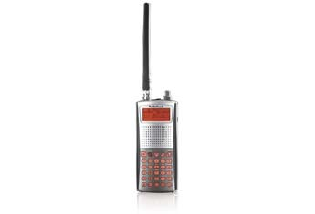
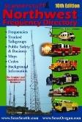
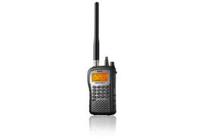
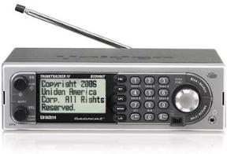
Monitoring Agency Radio Systems
Analog Scanners
V/UHF FM
Aircraft
Analog Trunking Scanners
Seattle, EPSCA
“Trunking”
“Triple Trunking”
Digital Scanners
P25 systems (Phoenix)
“Digital”

Slide 22
Going Beyond Amateur Radio
Emcomm volunteers may be asked to use the agency's own communication systems
Most served agencies will have their own communication systems and equipment
Ranging from modest to complex
Work with the served agency well in advance to determine
Whether the agency will need you to use its equipment
Under what conditions
On-air procedures will definitely be different
Training and drills may make Amateur Radio emcomm operators proficient

Slide 23
Summary
Any questions before the quiz?

Slide 24
Time for a Quiz
Take 30 Seconds adjust your workspace

Slide 25
30
Seconds

Slide 26
20
Seconds

Slide 27
10
Seconds

Slide 28
9
Seconds

Slide 29
8
Seconds

Slide 30
7
Seconds

Slide 31
6
Seconds

Slide 32
5
Seconds

Slide 33
4
Seconds

Slide 34
3
Seconds

Slide 35
2
Seconds

Slide 36
1
Seconds

Slide 37
Let's get started!

Slide 38
Topic 5a Question
When emcomm team members are called upon to operate on Public Safety Radio Systems, which of the following may they NOT do?
Use special "10 codes"
Use the served agency's standard operating procedure
Use the phonetic alphabet employed by the served agency
Engage in casual conversations

Slide 39
Topic 5a Question
Which of the following modes/devices would not be appropriate for you to use to transmit a message for a served agency?
Email on a computer with Internet connections
Fax machine
Land line telephone
ALL of these are appropriate and useable if needed

Slide 40
Topic 5a Question
Which of the following best describes the newer Emergency Medical Radio Services?
Ten UHF duplex frequencies and seven VHF simplex channels
Ten simplex VHF frequencies with pulsed tone encoders for each hospital
Seven UHF duplex frequencies and ten VHF simplex channels
The MedStar system with channels Med 1 through Med 10

Slide 41
Topic 5a Question
Which one of the following statements is true about trunked systems?
Trunked systems are able to operate without the use of computer controllers
The number of frequencies on a trunked system is always a multiple of 10
Amateur radio does not currently use this type of system
Most trunked systems have ample reserve capacity

Slide 42
Topic 5a Question
When emcomm teams work with a served agency, a number of assumptions are made. Which of the following assumptions are true?
Amateur radio operators can operate any communication equipment they encounter
There are NO significant differences between amateur radio operating procedures and the procedures used by the served agencies
Served agencies must provide training if Amateur Radio operators are to be used effectively
All phonetic alphabets are essentially the same and are thus interchangeable

Slide 43
Any Questions Before Starting Topic 5b?

